Slide 1
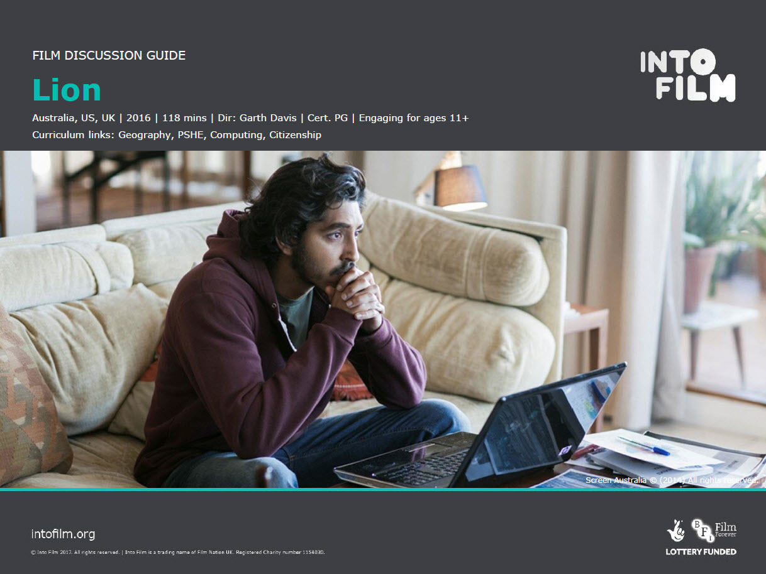
Lion the Movie
Year 8 Geography - Interconnections

Slide 3
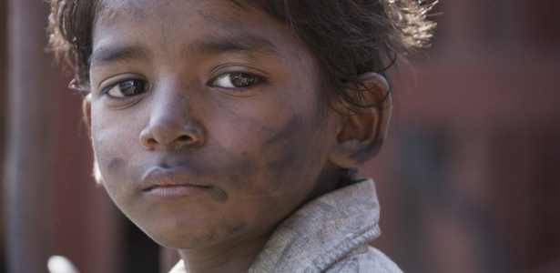

Slide 4
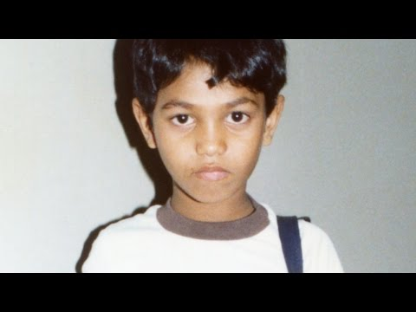

Slide 6
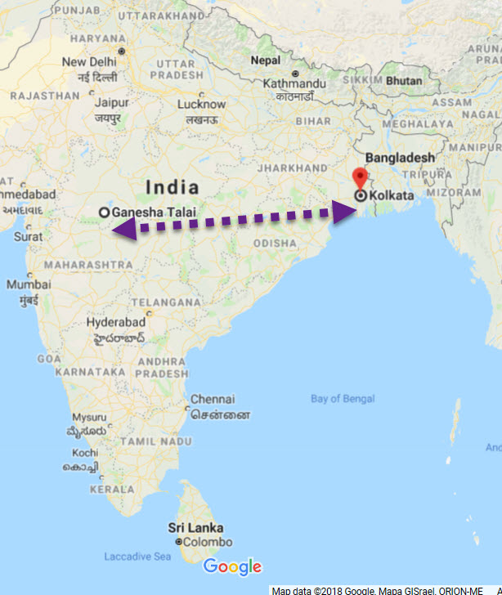
Ganesh Talai to Kolkata
How could we find out information on these two cities?
Find the latitude and longitude of these two cities.
Are they located in the polar, temperate or tropical climatic zones?
How far are these cities from Sydney?

Slide 7
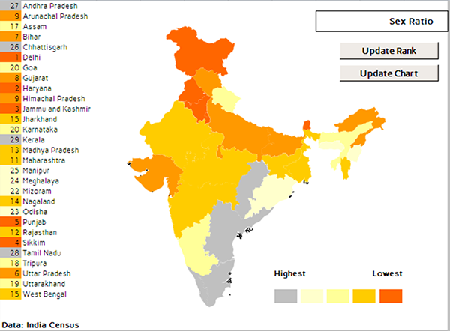
Not shown in the film
Saroo Brierley eliminated certain areas of the radius based on geography and weather patterns. “He knew he didn’t go through somewhere cold, so he cut out the cooler regions, and he knew he didn’t go through the mountains so he cut out that area. He brought in a heat map to look at temperature patterns.”

Slide 8
How did he locate his family?
Google Earth:
Brierley used a very deep technology within the product. He started out looking at the satellite imagery. He marked up a map, attached titles and descriptions, and he kept notes.
He set up a search radius, and he plotted that using the measuring tool.

Slide 9
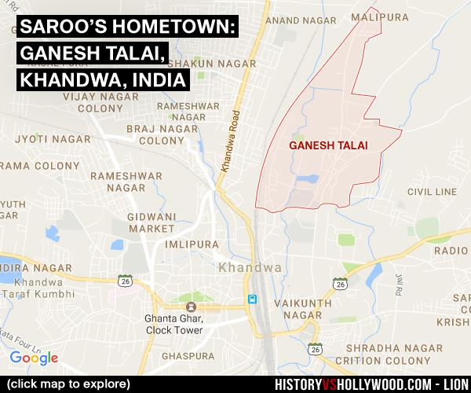
Train travel
Brierley estimated he was on the train for 14 hours. Retracing his steps as an adult, he looked up the train speeds and created a search radius based on the estimated distance travelled.

Slide 10
Other tools Saroo used
Though Google gets the most credit in “Lion,” Brierley also relied on YouTube to watch high definition videos of the Khandwa train station that offered more visual details than Google Earth could, and Facebook to communicate with locals to confirm landmarks. He wanted to be as certain as possible before hopping on a plane and getting his hopes up.

Slide 11
Saroo’s interaction with technology
Viewers get to both trace Brierley’s physical journey as a child and his interaction with the technology, along with personal insights from the family and anecdotes about various landmarks. It begins with the Howrah railway station in Calcutta, and even shows young Brierley’s flight path from Calcutta to Tasmania. Viewers can see images of the water tower and fountain in Khandwa, the landmarks Brierley used to identify his hometown, as well as a hand drawn map by his mother, Sue, based on his recollections.

Slide 12
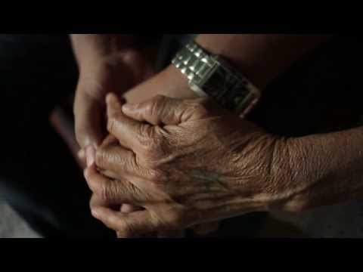

Slide 13
Discussion points
How did Saroo become lost from his brother, so far from home?
Think back to when Saroo initially wakes up in Kolkata, How does the camera help convey his initial reaction to the situation he is in?
How did Saroo first react to his new home in Tasmania? How do his new parents try to make him feel at home?
Why was Saroo reluctant to tell his Australian parents of his attempt to find his birth mother?

Slide 14
Extension activities
Saroo eventually finds his birth mother through using Google Earth.
What other pieces of technology can you think of that might have helped him?

