Slide 1
Year 8
Geographical Skills Revision

Slide 2
GEOGRAPHICAL SKILLS - SYLLABUS
Geographical tools are to be integrated in teaching and learning in the mandatory courses and in the elective course. The use of information and communication technologies (ICT) with geographical tools will assist students to gather, analyse and communicate geographical information in appropriate formats. In Stage 5 students learn to use the Stage 5 geographical tools while continuing to incorporate the Stage 4 geographical tools.

Slide 3
WHAT DO WE NEED TO COVER?
Maps
use various types of maps (physical, political, topographic, thematic)
identify and use elements of maps, including legend, direction, title, scale, border
distinguish between different types of map projections
distinguish between large-scale and small-scale maps
Use the scale of map to calculate distance
locate features using degrees and minutes of latitude and longitude, GR and AR
calculate the area of a feature
calculate the density of a feature
measure bearings on a map
calculate local relief (using shading, spot heights, colour and contour lines)
identify the aspect of a slope
construct a cross-section
calculate the gradient of a slope
construct a transect
read and interpret synoptic charts (wind direction/ speed, pressure patterns, fronts, rainfall)

Slide 4
WHAT DO WE NEED TO COVER?
Fieldwork
features and uses of a compass to determine direction, clinometers and tape measure
features and uses of weather instruments, a Beaufort wind scale and cloud identification charts
features and uses of vegetation identification charts
Design interviews, construct surveys
Photographs
Recognise different types of photos (oblique, aerial, ground-level photographs and satellite imagery)
draw a line drawing, undertake a field sketch
collect and interpret photographic images
Graphs and Statistics
construct and interpret population pyramids
construct and interpret bar, column, line, climatic and proportional graphs
construct and interpret divided bar and column graphs, and composite line graphs
identify and calculate maximum, minimum, total, range, rank and average

Slide 5
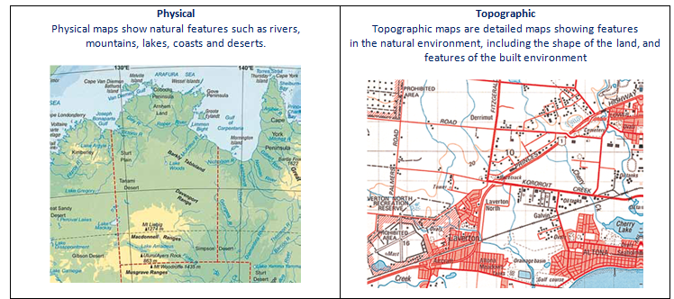
MAP INTERPRETATION / TYPES OF MAPS
Maps are a representation of a part or whole of the Earth’s surface. As you should already know they can be done in different ways. There are various types of maps (physical, political, topographic, thematic).

Slide 6
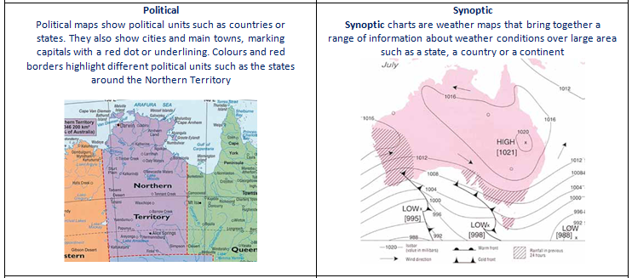
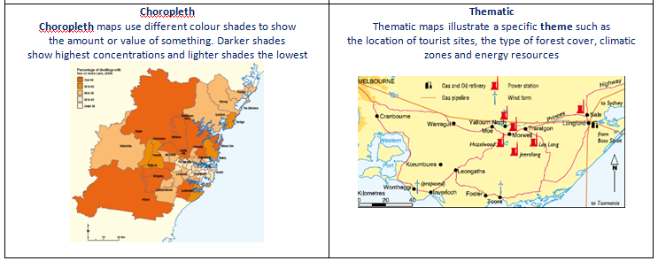

Slide 7
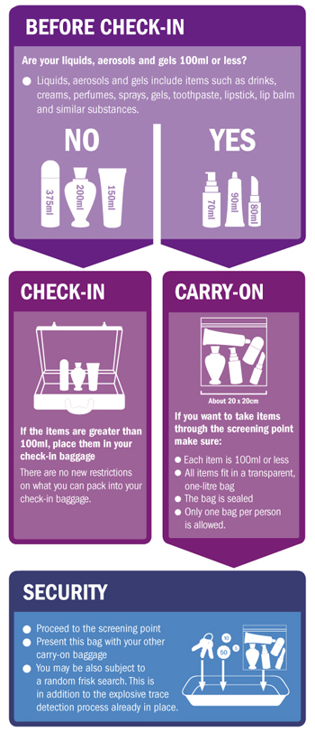
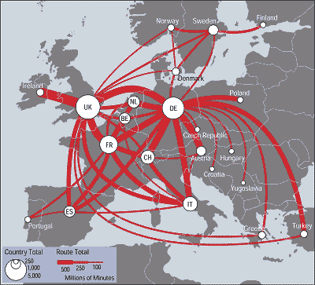
MAPS AND FLOW CHARTS
Flowline maps are designed to show movement. Arrows are used to show both the direction of movement and often the amount of the thing being moved.

Slide 8
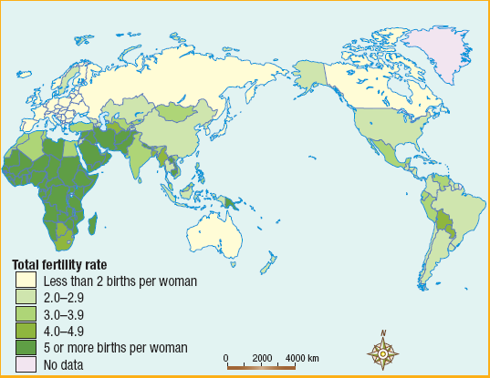
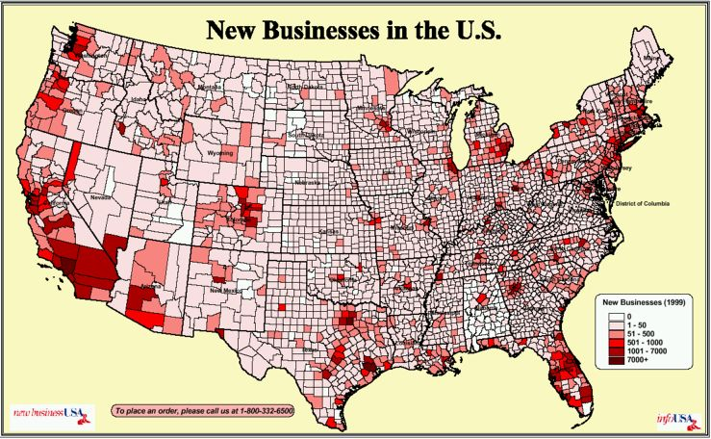
This map is an example of a Choropleth map, shading of one colour is usually used to show equivalent areas.
OTHER TYPES OF MAPS
The Thematic map show new businesses in the US are distributed using different colours.

Slide 9
BOLTS
Letter | Description
B | is for the border that surrounds a map. A ruler needs to be used when a border is drawn. A border needs to stand out and clearly define a map.
O | is for orientation. All maps require an arrow that shows the direction of north.
L | is for legend, which is also called a key. The legend or key unlocks the symbols and colours on a map and tells us what they mean. Symbols are simple pictures that are used to represent features on a map. They make a map easy to read. The colour scheme for symbol drawing is: brown for land features, green for vegetation, blue for water and black/red for human features.
T | is for title. The title of the map contains very specific information about that map and contains place name and description of what is found on the map.
S | is for scale. Maps are drawn much smaller than the features they represent. A scale allows people to determine the actual distance between places on a map. The scale can be shown in three ways: as a linear scale, statement scale or ratio scale. Not to Scale is written on a map that has not been drawn to scale.

Slide 10
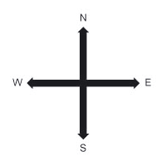
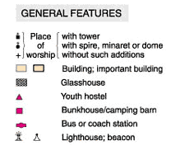
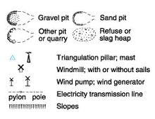
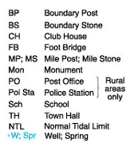
BOLTS
B= BORDER - This is the feature around a map
O= ORIENTATION - Compass directions are vital for finding your way around a map.
L= LEGEND identify types of boundaries, roads, buildings, agriculture, industry, places of interest

Slide 11
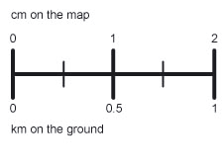
BOLTS
= TITLE - This will give you a general idea about the information it stores.
S= SCALE - The scale of a map allows a reader to calculate the size, height and dimensions of the features shown on the map. The scale on a map is the ratio between real life sizes. The scale below is for a 1:50,000 scale map. At this scale, 1 cm on the map represents 50,000 cm on the ground (= 500 metres or 0.5 kilometres).

Slide 12
DIFFERENT TYPES OF MAP PROJECTIONS
The earth is a sphere, which is a three-dimensional (3‑D) shape. The most accurate method of representing the 3-D earth is to make a scale model of it called a globe. The 3-D earth can be represented on a two dimensional (2-D) surface by using a map projection where latitude and longitude are projected from the globe onto the flat surface. To do this, different parts of the globe have to be distorted. Map projections can be one or more—but never all—of the following:
  equal area, where area is shown accurately
  conformal, where shape is shown accurately
  conical, where scale is shown accurately
  true direction, where all directions are accurate
  equidistant, where distance is accurate.

Slide 13
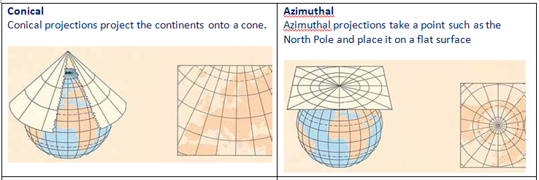
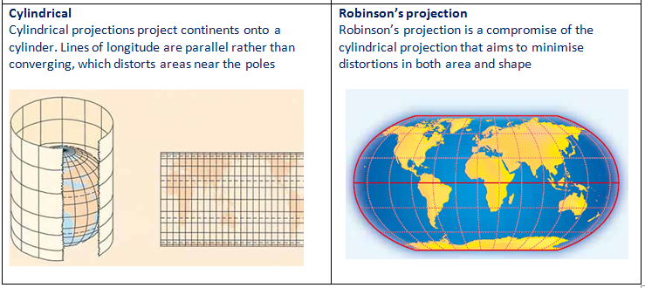

Slide 14
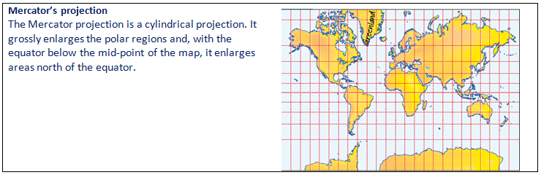
DIFFERENT TYPES OF MAP PROJECTIONS

Slide 15
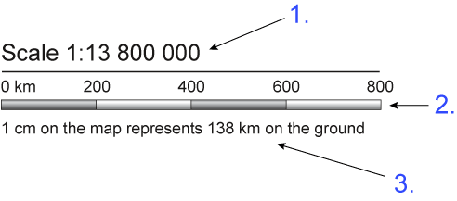
The scale on a map indicates how much a given distance on a map represents on actual land. Scale can be shown on a map in three different ways:
1. As a linear scale, which is shown by a line divided into sections that represent a distance, You will need to use your ruler and then write determine the scale. The scale is 1cm is equal to 1000m, 1cm is equal to 1km.
SCALE ON A MAP

Slide 16
SCALE ON A MAP
2. As a numeric scale, which is written as a ratio and is called a representative fraction (RF). A scale of 1:100, 000 means that 1 centimetre on the map represents 100 000 centimetres (or 1000 metres or 1 kilometre) on the ground.
3. As a sentence, for example: 1 centimetre represents 1000 metres or 1 centimetre to 1 kilometre.
The scale of the map allows you to convert distance on the map to distance on the ground.

Slide 17
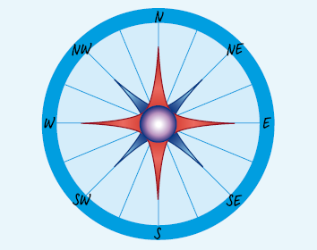
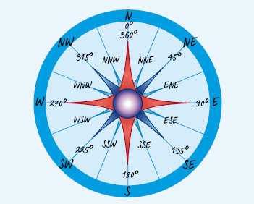
DIRECTION
You find the direction of one place from another by using the points of a compass. The four cardinal (main) points are north (N), south (S), east (E) and west (W). These points can be divided to form the 8-point and 16-point compasses. The 16 points of the compass give a general direction but sometimes more accuracy is needed.

Slide 18
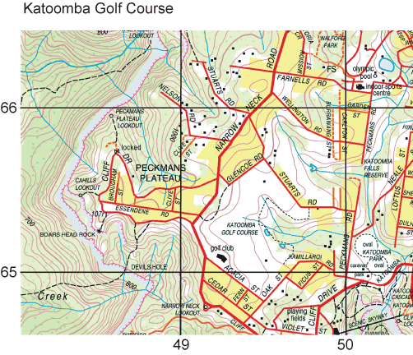
Topographic map are a large scale map that shows the relief of the land and height above sea level using contour lines. Details such as walking tracks and even water tanks can be shown by symbols explained in the legend or key.
TOPOGRAPHIC MAP

Slide 19
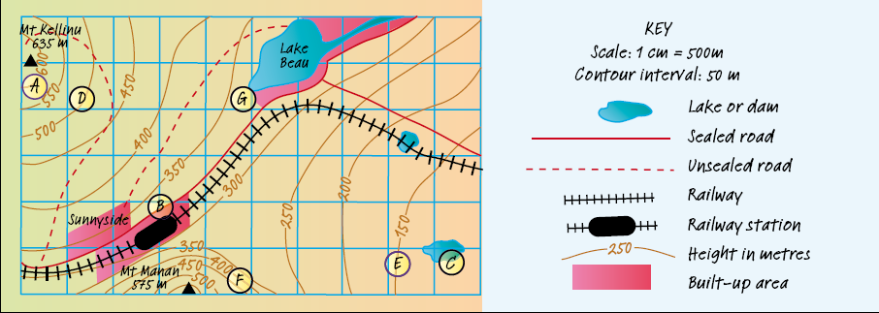
TOPOGRAPHIC MAP
The lines on a topographic map form a grid pattern, which helps pinpoint locations, these are divided into numbered squares.
The grid squares created are usually one square kilometre in area These squares can be used to give a place a four or six-figure grid reference. It is important that you know both four-figure (AR) and six-figure (GR) references.

Slide 20
AREA AND GRID REFERENCE
When a grid is drawn on a map, the horizontal lines are called northings and the vertical lines are called eastings.
Eastings are numbered from west to east. Northings are numbered from south to north.
Area reference (AR) a four-figure numerical location point made up of a two-figure eastings reading and a two-figure northings reading e.g. 0467
Grid reference (GR) a six-figure numerical location point made up of a three-figure eastings reading and a three figure northings reading e.g. 045675.
Eastings are ALWAYS given before northings.

Slide 21
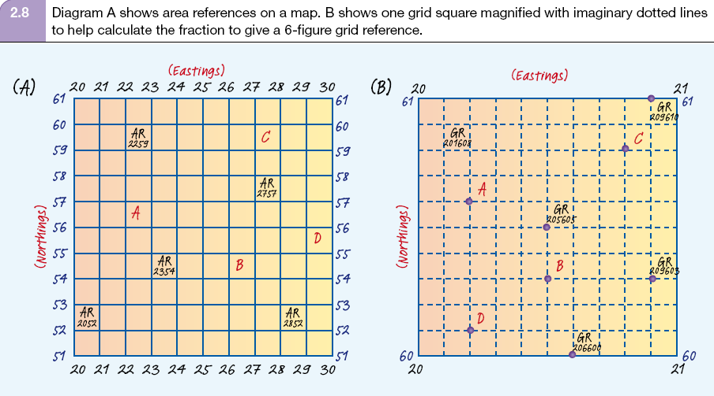
AREA AND GRID REFERENCE

Slide 22
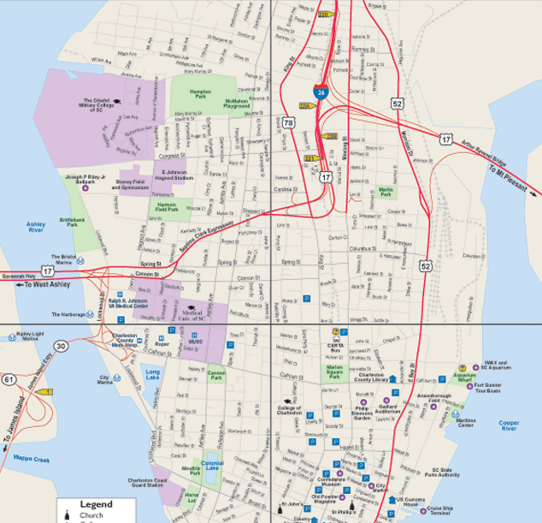
QUADRANT
Dividing up the map into 4 areas. NW, NE, SW,SE

Slide 23
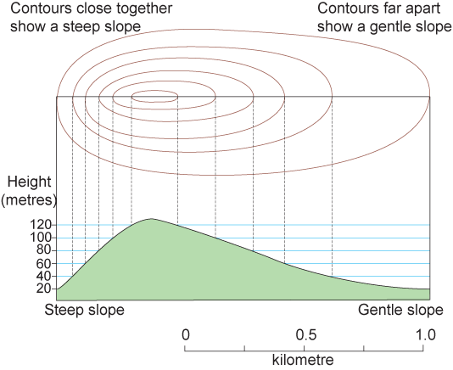
Contours are lines on maps which indicate the land height above sea level.
Contour lines that are close together indicate a steep slope, while contours that are widely spaced indicate a gentle slope.
The shape of landforms can also be recognised from the pattern the contours make.
CONTOUR LINES

Slide 24
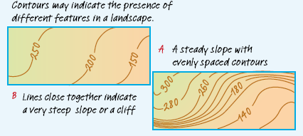
CONTOUR LINES
Recognising a range of physical features from patterns made by contour lines does take practice. Two general rules are:
  Where contour lines are far apart it means that the change in height over a given distance is small—it is a gentle slope
  Where contour lines are close together it means that the change in height over a given distance is large— it is a steep slope

Slide 25
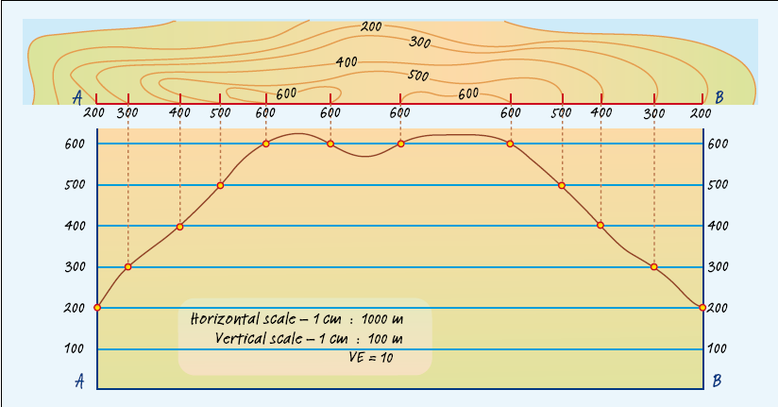
CROSS SECTION
Cross section looks at the land if it was sliced in half
Asked to complete cross section between two points

Slide 26
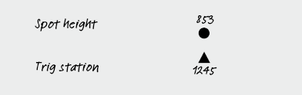
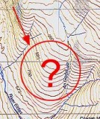
SPOT HEIGHTS
A spot height is indicated by a dot point and a number or a triangle and a height value.
Local Relief is the different in height on a line drawn between two points.
Aspect is the direction a slope is facing.

Slide 27
GRADIENT AND SLOPE
The gradient of an area is the vertical rise of slope over a given horizontal distance. To calculate the gradient of a slope between two points, use this simple formula:
Gradient = Horizontal distance (run)
Difference in height (rise)
Rise/Run
= 1200/30
= 40/1
= 1:40
Gives us information regarding steepness of a slope
1 metre incline for every 40 metres we walk

Slide 28
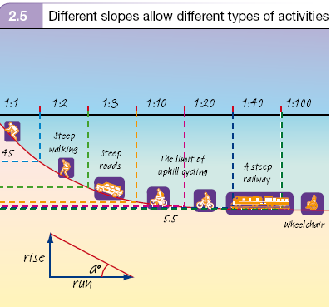
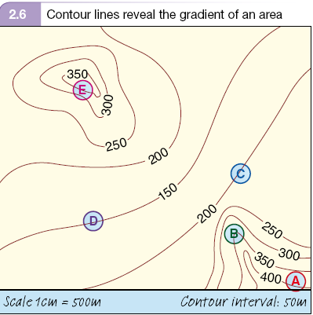
GRADIENT AND SLOPE

Slide 29
LATITUDE
Lines of latitude are imaginary lines that run around the earth’s circumference. They run parallel to each other and is measured in the number of degrees north (N) or south (S) of the equator, which is at 0 degrees (0°). The equator divides the earth into two parts—the northern and southern hemispheres. The latitude of the North Pole is 90°N and that of the South Pole is 90°S.

Slide 30
LONGITUDE
Longitude is measured in degrees east or west of the prime meridian, which runs through Greenwich in London, England, at 0°. Each line is called a meridian of longitude and is numbered east to west from the prime meridian at 0° around the earth to 180° (known as the International Date Line). They are NOT parallel to each other so all the lines meet at the North and South Poles.

Slide 31
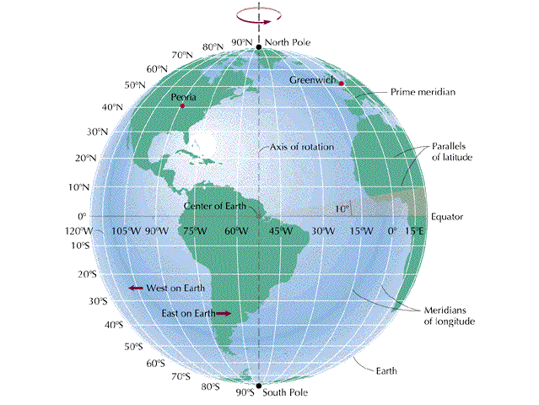
LATITUDE AND LONGITUDE
Always write LATITUDE BEFORE LONGITUDE

Slide 32
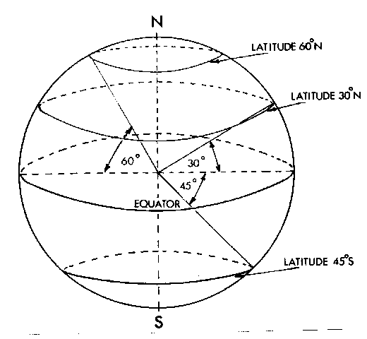
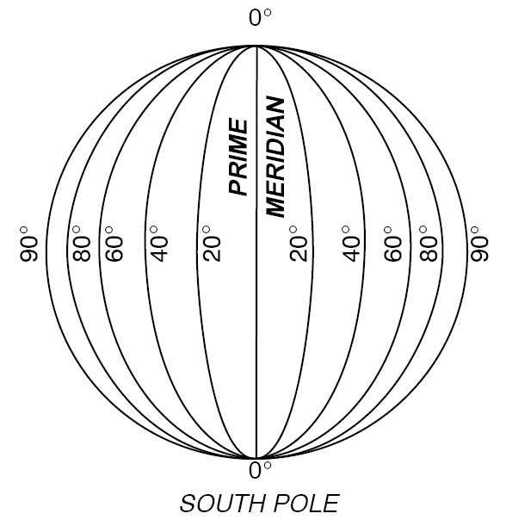
LATITUDE AND LONGITUDE
Parallels of latitude: lines that run across the map from east to west; 5 main lines of latitude
              Equator
              Tropic of Cancer
              Tropic of Capricorn
              Arctic Circle
              Antarctic Circle
Meridians of longitude: lines that run up and down the map from north to south; 2 main lines of longitude
              The Prime Meridian at O °
              The International Date Line (IDL) which is around the 180 ° in the Pacific Ocean

Slide 33
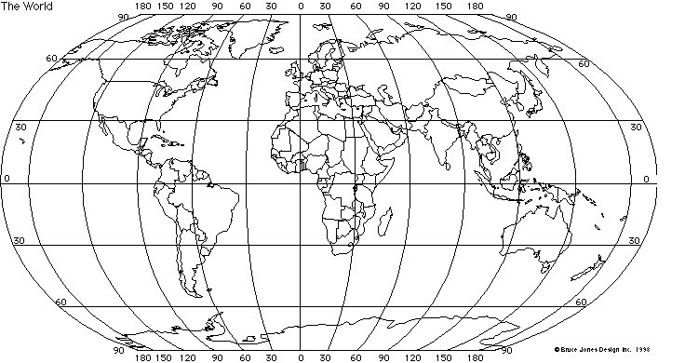
LATITUDE AND LONGITUDE

Slide 34
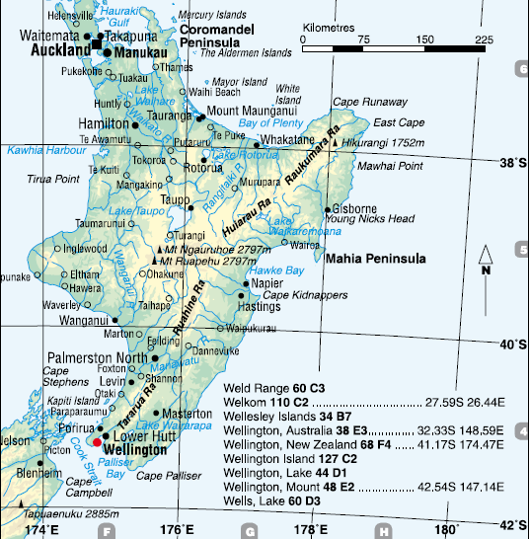
FINDING PLACES USING LATITUDE AND LONGITUDE
Lines of latitude and longitude form a grid system, similar to Grid and Area References. The map below shows that New Zealand’s capital Wellington has a latitude of approximately 41°S of the equator and 174°E of the prime meridian.

Slide 35
SYNOPTIC CHARTS
Synoptic charts, are used to show the elements of the weather at a particular time of the day. Isobars are the lines on a weather map showing places of equal air pressure. Isobars enclose features called ‘cells’, which may be either high pressure or low pressure cells and shows the relationships between air pressure and wind direction/speed.
High pressure brings fine, clear stable weather
Low pressure bring cloudy unsettled weather with chance of rain
Winds around a high pressure system are anticlockwise (opposite in the Northern Hemisphere)
Winds around a low pressure system clockwise (opposite in the Northern hemisphere)

Slide 36
SYNOPTIC CHARTS
Low pressure systems – isobar numbers decrease towards the centre = unstable atmosphere, cloudy skies, rain and strong winds
High pressure system – isobar numbers increase towards the centre = gentle winds, clear skies, little chance of rain
Cold fronts – cold air overtakes warm air = temperature likely to fall, rain occurs and wind direction changes

Slide 37
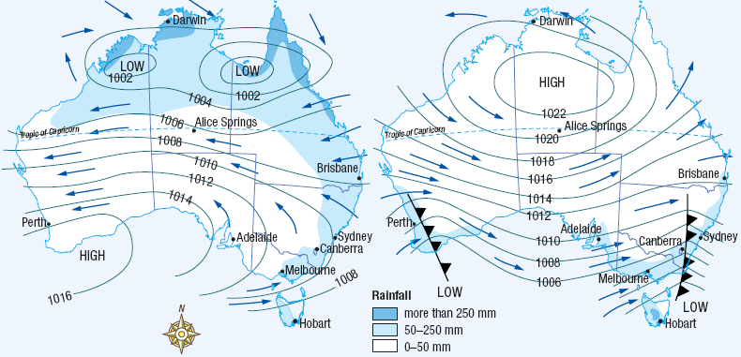
SYNOPTIC CHARTS

Slide 38
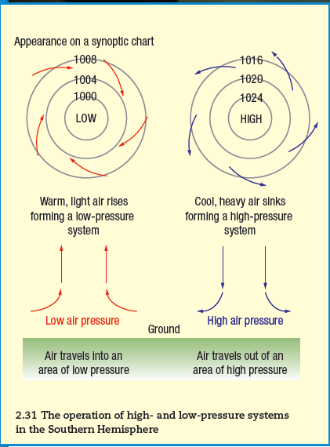
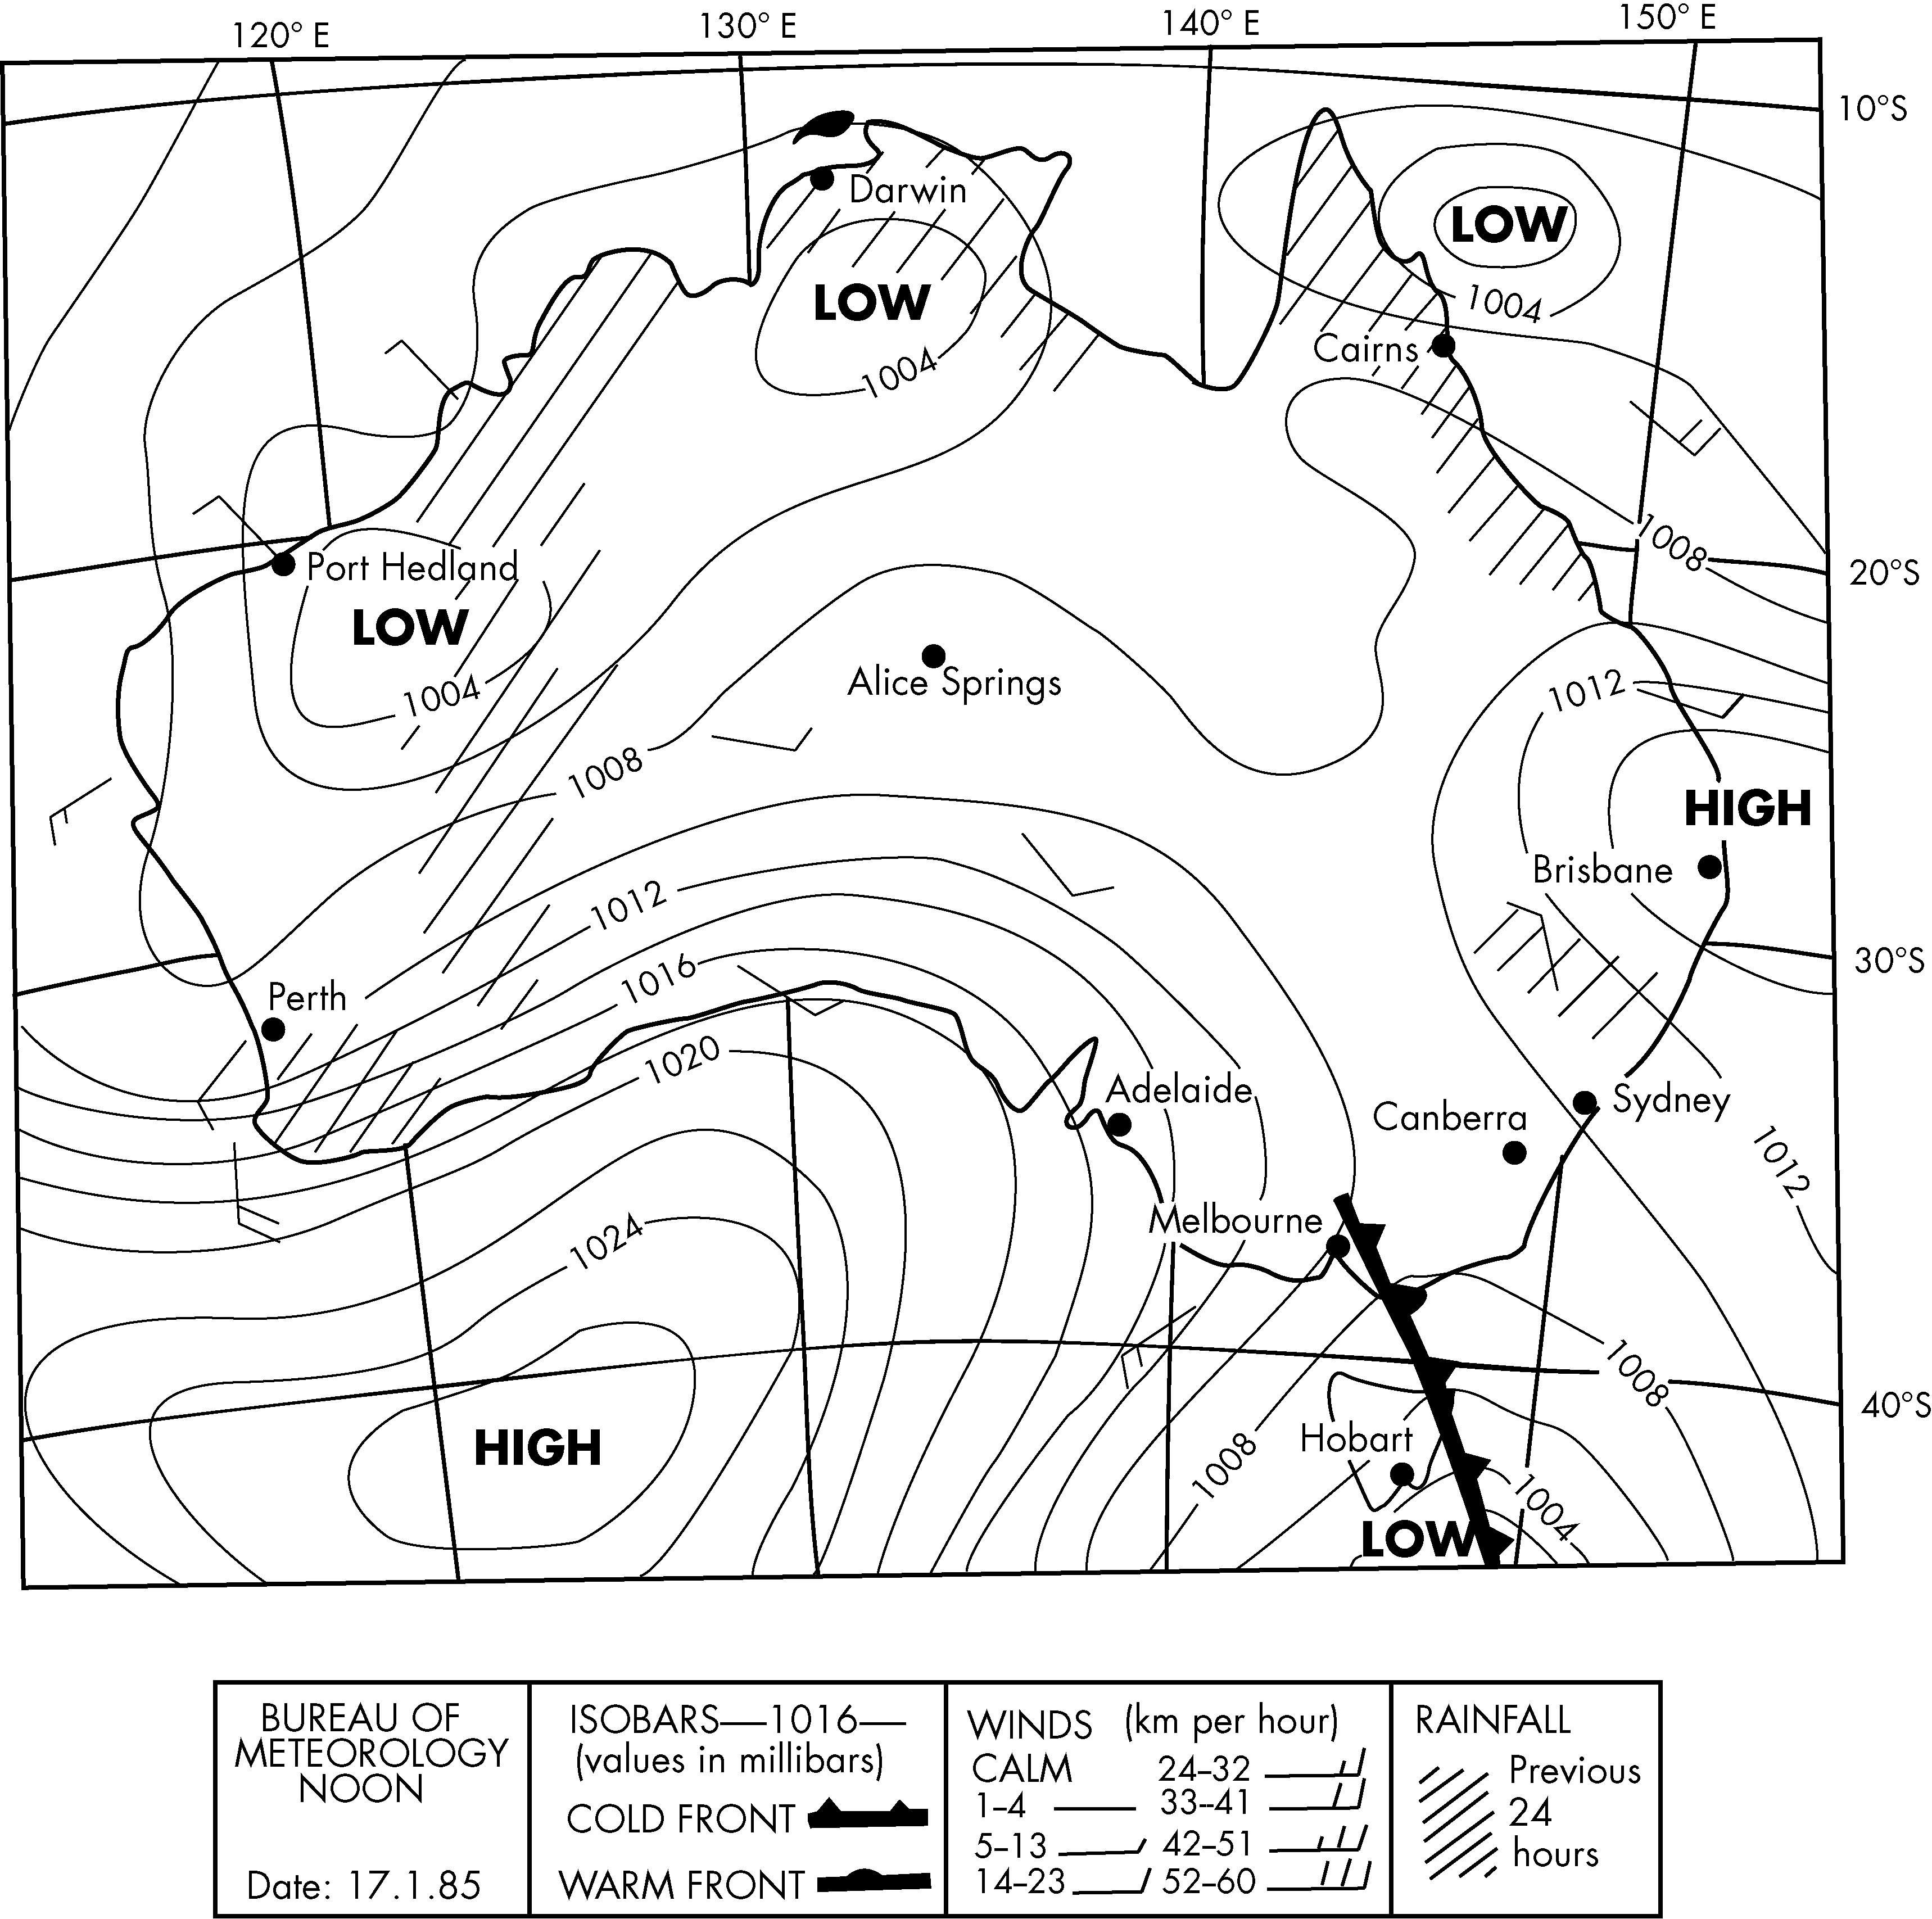
SYNOPTIC CHARTS

Slide 39
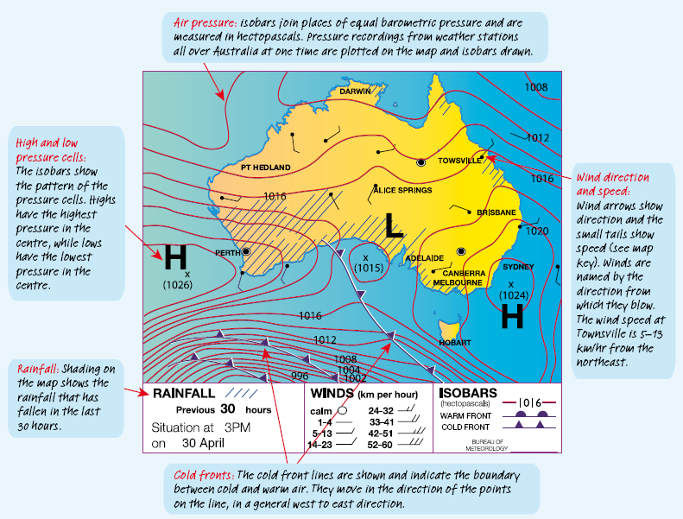

Slide 40
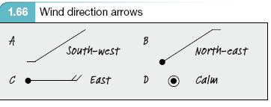
SYNOPTIC CHARTS
Lines point to a location the way the wind is blowing
Wind direction named from where it comes
Wind speed measured by tail and key
The closer the isobars the stronger the wind

Slide 41
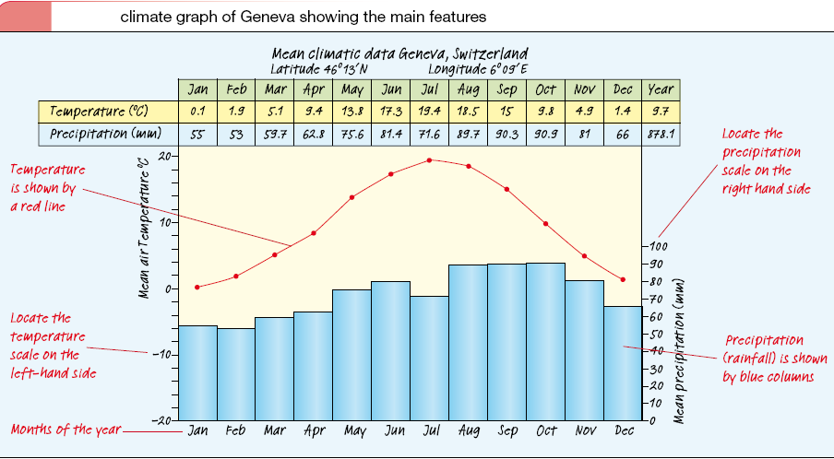
CLIMATE GRAPHS
A climatic graph is a graph that shows average temperature and precipitation (rainfall) for a location over a twelve-month period. It combines a line graph to show temperature with a column graph to show precipitation.

Slide 42
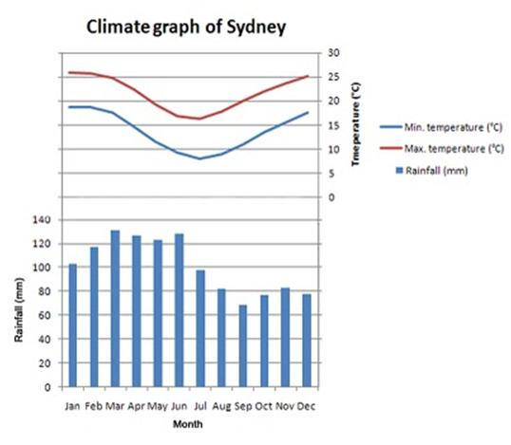
CLIMATE GRAPHS
  1. Precipitation (rainfall) in columns
  2. Temperature on lines
  3. Temperature range
  = Highest minus lowest
  4. Average annual rain fall
  = add up each of the12 months.
  5. Note the difference between a
  Southern vs Northern hemisphere climate graph
  6. Nth Qld map = hot dry winter, hot wet summer.
  7. Southern Australia = 4 seasons

Slide 43
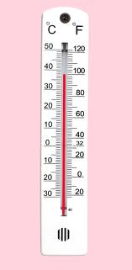
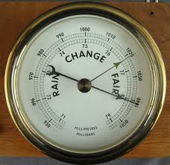
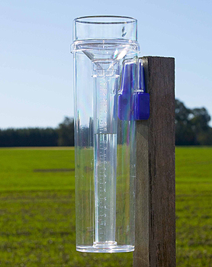
WEATHER INSTRUMENTS
A THERMOMETER measures the air temperature.
A BAROMETER measures air pressure.
A RAIN GAUGE measures the amount of rain that has fallen over a specific time period.

Slide 44
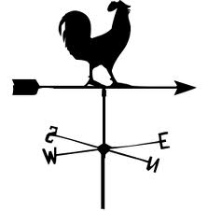
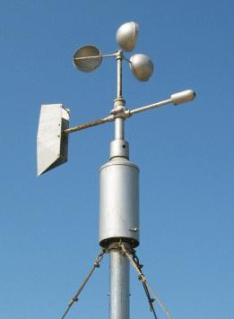
WEATHER INSTRUMENTS
A WIND VANE is an instrument that determines the direction from which the wind is blowing.
An ANEMOMETER measures wind speed. The cups catch the wind, turning a dial attached to the instrument

Slide 45
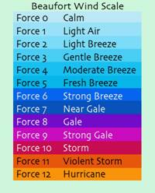
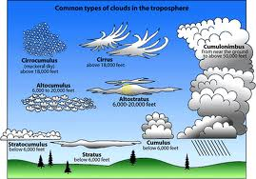
WEATHER INSTRUMENTS
The BEAUFORT SCALE is a measure that relates wind speed to observed conditions at sea or on land.
The CLOUD CHART includes cloud names such as cirrus, cumulus, stratus, altocumulus, altostratus, and cumulonimbus

Slide 46
TYPES OF PHOTOGRAPHS
Geographers use photos as a tool to identify and record geographic features and information.
The four main types of photos are:
  ground photos
  vertical aerial photos
  oblique aerial photos
  satellite images.
All types are valuable tools as sources of information that geographers use to make observations and decisions

Slide 47
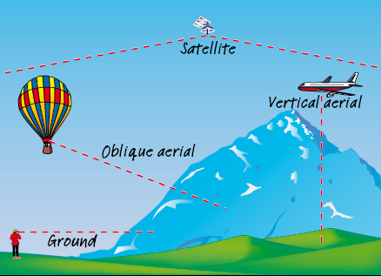
TYPES OF PHOTOGRAPHS

Slide 48
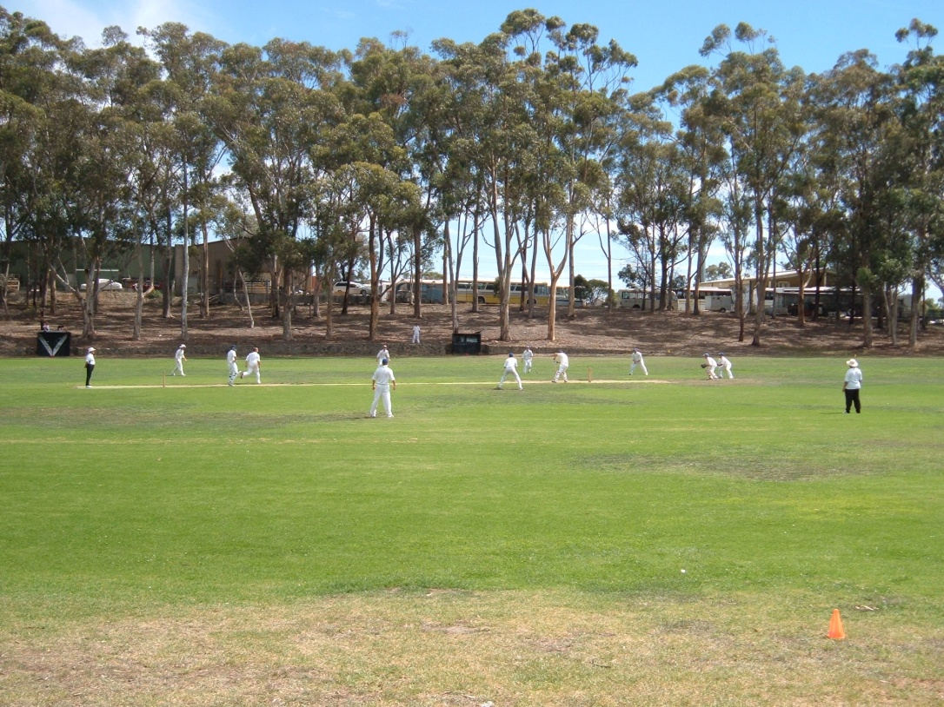
TYPES OF PHOTOGRAPHS
Ground Photo – taken at ground level with the camera pointed horizontally

Slide 49


TYPES OF PHOTOGRAPHS
Aerial photographs
  Vertical
  Oblique

Slide 50


TYPES OF PHOTOGRAPHS
Satellite

Slide 51
TYPES OF PHOTOGRAPHS
COMPARING PHOTOS WITH MAPS - Geographers often compare aerial photos with topographic maps to get a fuller understanding of an area.

Slide 52

THANK YOU
QUESTIONS?

